Slide 1


INFORMS 2015 Workshop
What’s New in DiscoverSim Version 2
John Noguera, P. Eng.
CTO & Co-founder
SigmaXL, Inc.
www.SigmaXL.com
October 31, 2015

Slide 2
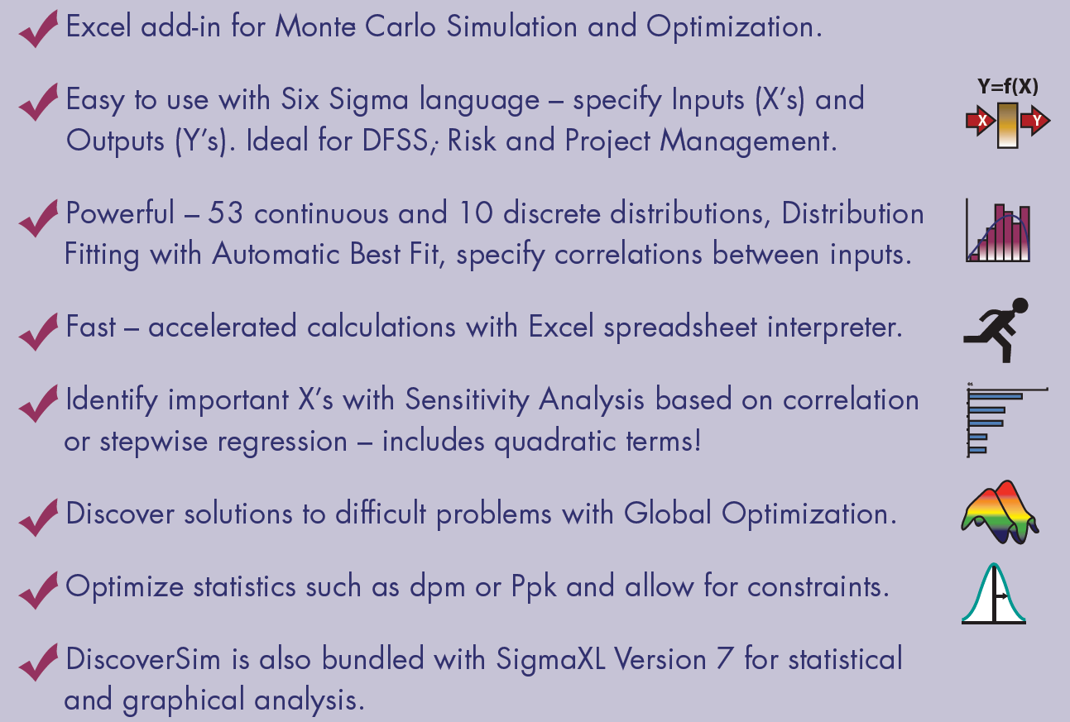
DiscoverSim Features

Slide 3
DiscoverSim Optimization Metrics
Optimization Goal: | Minimize
Multiple Output Metric: | Weighted Sum | Deviation from Target
Statistic: | Mean Median 1st quartile 3rd quartile Percentile (%) Minimum Maximum Standard Deviation Variance Mean Squared Error/Taguchi Loss Function (requires Target) Skewness Kurtosis Range IQR (75-25) Span (95-5) Actual DPM (defects per million – requires LSL/USL) Actual DPMU (Upper – requires USL) Actual DPML (Lower – requires LSL) Calculated DPM (defects per million assuming normal distribution – requires LSL/USL) Calculated DPMU (Upper – requires USL) Calculated DPML (Lower – requires LSL) | Mean (requires Target)

Slide 4
DiscoverSim Optimization Metrics
Optimization Goal: | Maximize
Multiple Output Metric: | Weighted Sum | Desirability
Statistic: | Mean Median 1st quartile 3rd quartile Percentile (%) Minimum Maximum Standard Deviation Variance Mean Squared Error (requires Target) Skewness Kurtosis Range IQR (75-25) Span (95-5) Pp (requires LSL/USL) PpU (Upper – requires USL) PpL (Lower – requires LSL) Ppk (requires LSL/USL) Cpm (requires Target/LSL/USL) %Pp (Percentile Pp – requires LSL/USL) %PpU (Percentile PpU – requires USL) %PpL (Percentile PpL – requires LSL) %Ppk (Percentile Ppk – requires LSL/USL) | Mean (requires Target and LSL, USL or LSL/USL)

Slide 5

Distributions in DiscoverSim

Slide 6






DiscoverSim Components
Accelerated Excel Spreadsheet Interpreter
Marsaglia “KISS + Monster” RNG

Slide 7
DiscoverSim Cost
$995 (US) includes all features: Simulation, Optimization, Distribution Fitting and SigmaXL Statistics. The license is perpetual.
Academic price is $200. This is an unlimited perpetual license.
Quantity discounts are available. Professors and Consultants may be eligible for a free license.
One year of free maintenance that includes technical support and updates.
After year 1, optional maintenance cost is 20% of purchase price.
Currently we do not have concurrent licensing available.

Slide 8
DiscoverSim Limitations
No Developer Kit.
No direct access to Aptech Gauss Engine or MIDACO-SOLVER.
Multi-threading controlled by Excel.
Not a Discrete Event Simulation tool.
Decision Trees are possible but require IF statements.
No automated Efficient Frontier.
Stochastic Information Packets (SIPs) are import only. Currently we do not provide SIP compliant output reports.
Currently weak on TSP problems with AllDifferent constraint (to be addressed in a future update).

Slide 9


Slide 10
What’s New in DiscoverSim
Version 2
Nelder-Mead simplex optimization for fast local non-smooth problems.
Exhaustive Discrete optimization – all combinations for small discrete problems.
Genetic Algorithm improved constraint handling using MIDACO’s Oracle method.
Powerful Hybrid of MIDACO, Genetic Algorithm, Exhaustive Discrete, Nelder-Mead (NM) and Sequential Quadratic Programming (SQP).

Slide 11
What’s New in DiscoverSim
Version 2
Nonnormal Process Capability for all 53 continuous and 10 discrete distributions.
Improved robustness on parameter estimation for distribution fitting using the methods of BFGS and Nelder-Mead.
Threshold distributions solved using a hybrid of Maximum Likelihood and Iterative Bias Reduction. Added option to exclude threshold distributions from distribution fitting.
Anderson Darling P-Values for all continuous distributions via table lookup. Tables with critical values computed using extensive Monte Carlo simulations.

Slide 12
What’s New in DiscoverSim
Version 2
Weighted and Unweighted Custom Distributions
Import Stochastic Information Packet (SIP).
  A SIP is a standard library of data (see ProbabilityManagement.org for more details on this standard).
  DiscoverSim treats this as a custom distribution with unweighted data and is sampled sequentially.

Slide 13
What’s New in DiscoverSim
Version 2
Discrete Control now includes a Step size, so is no longer limited to integer increments.
Insert DSIM function such as Percentile or Capability Metric. This can then be used in a constraint.
New Percentile statistic for optimization.
Correlations > Reset with Blanks allows you to specify correlations between inputs without the constraint of requiring independence on the other inputs.

Slide 14
Distribution Fitting - Maximum Likelihood Estimation of Parameters
Maximum likelihood (ML) estimates of the parameters are calculated by maximizing the likelihood function with respect to the parameters.
The likelihood function is simply the sum of the log of the probability density function (PDF) for each observation.
Initial parameter values are derived from method of moments estimates or, if applicable, ordinary least squares.

Slide 15
Distribution Fitting - Maximum Likelihood Estimation of Parameters
The maximum likelihood parameter estimates are then calculated using the method of Broyden, Fletcher, Goldfarb, and Shanno (BFGS).
The BFGS method approximates Newton's method, a class of hill-climbing optimization techniques that seeks a stationary point of a (preferably twice continuously differentiable) function.
These methods use both the first and second derivatives of the function. However, BFGS has proven to have good performance even for non-smooth optimizations.

Slide 16
Distribution Fitting - Maximum Likelihood Estimation of Parameters
If BFGS fails to converge, then the robust method of Nelder-Mead is employed.
The standard errors of the parameter estimates are derived from the Hessian matrix. This matrix, which describes the curvature of a function, is the square matrix of second-order partial derivatives of the function.

Slide 17
Distribution Fitting – Threshold Distributions
If the threshold parameter is not known, maximum likelihood is used to estimate the parameters. For some data sets, the likelihood function for threshold models is unbounded, and the maximum likelihood methodology fails (infinite likelihood). In other cases multiple modes are possible, leading to unstable results.
An alternative method, the iterative bias reduction procedure by Lockhart & Stephens is a robust alternative to maximum likelihood. This is an iterative methodology that evaluates the threshold based on the difference between the minimum value of the variate and the prediction for the minimum value (using cdf inverse), conditional on the current values of the remaining parameters (solved using BFGS maximum likelihood).

Slide 18
Distribution Fitting – Threshold Distributions
The probability for the minimum used in the cdf inverse has several possible choices as used in probability plotting positions, including the most common:
  (i-0.5)/N
  i/N
  i/(N+1)
  (i-0.3)/(N+0.4)
The minimum is specified with i=1. Using Monte Carlo small sample simulation we determined that cdf inverse((1-0.5)/N) produced the best overall result for threshold estimation (minimum bias against known). The exception to this was the 2 Parameter Exponential where the predicted minimum value = scale/N gave minimum bias for small samples.

Slide 19
Distribution Fitting – Threshold Distributions
Initial estimates of Threshold use bias reduction with method of moments (or least squares if applicable) on the other parameters.
In some cases maximum likelihood will produce the best parameter estimates (e.g. 3 Parameter Weibull with shape > 2), in others the iterative bias procedure is the best or only solution (e.g. 3 Parameter Weibull with shape < 1).
In the case of 3 Parameter Weibull, one can use likelihood profiling to select which method to use, but this “switch” is not generally applicable to all threshold distributions.

Slide 20
Distribution Fitting – Threshold Distributions
DiscoverSim will attempt to solve the threshold distribution using BFGS maximum likelihood as well as with iterative bias reduction.
If maximum likelihood fails, then iterative bias reduction is used. If both successfully converge, the result producing the lowest Anderson Darling statistic is selected.
There are good alternative methods to the iterative bias reduction, such as Maximum Product Spacing, but in the context of batch distribution fitting, we consider the above hybrid to be the best overall approach.

Slide 21
Distribution Fitting – Goodness of Fit
The Anderson Darling statistic measures how well the data fits a particular continuous distribution - the smaller the AD value, the better the fit. In general, when comparing several distributions, the distribution with the smallest AD statistic has the best fit to the data.
Anderson Darling p-values are obtained from tabular interpolation. These tables were produced using extensive Monte Carlo simulations, varying sample size and the shape parameter(s) - if applicable. A minimum of 50,000 replications were used to obtain the critical values.
  For those distribution cases where published critical values exist, see D’Agostino & Stephens (1986), the simulation results were compared and found to be a close match (within 1% error for large sample asymptotic, 2.5% for small sample).

Slide 22
Distribution Fitting – Goodness of Fit
In batch mode, all of the distributions are sorted by the AD statistic, smallest to largest.
If the data set is large (N > 500), then a random subset of 500 is selected and AD is estimated. The 10 distributions with the lowest AD statistic are then recomputed using the entire data set and resorted. This process dramatically speeds up the batch process for large data sets.
The Chi-Square goodness of fit test and associated p-value are used when distribution fitting with discrete distributions.

Slide 23
Distribution Fitting – Nonnormal Process Capability Indices – Z Score
The Z-Score method (default) for computing process capability indices utilizes the inverse cdf of the normal distribution on the cdf of the nonnormal distribution.
Normal based capability indices are then applied to the transformed z-values.
This approach offers two key advantages:
  The relationship between the capability indices and calculated defects per million is consistent across the normal distribution and all nonnormal distributions
  Short term capability indices Cp and Cpk can be estimated using the standard deviation from control chart methods on the transformed z-values.

Slide 24
Distribution Fitting – Nonnormal Process Capability Indices – Percentile (ISO) Method
The Percentile method to calculate process capability indices uses the following formulas:
  Ppu = (USL – 50th percentile)/(99.865 percentile – 50th percentile)
  Ppl = (50th percentile – LSL)/(50th percentile – 0.135 percentile)
  Ppk = min(Ppu, Ppl)
  Pp = (USL – LSL)/( 99.865 percentile – 0.135 percentile)

Slide 25
Distribution Fitting – Nonnormal Control Charts – Individuals Original Data
The Individuals – Original Data chart displays the untransformed data with control limits calculated as:
  UCL = 99.865 percentile
  CL = 50th percentile
  LCL = 0.135 percentile
The benefit of displaying this chart is that one can observe the original untransformed data.
Since the control limits are based on percentiles, this represents the overall, long term variation rather than the typical short term variation. The limits will likely be non-symmetrical.

Slide 26
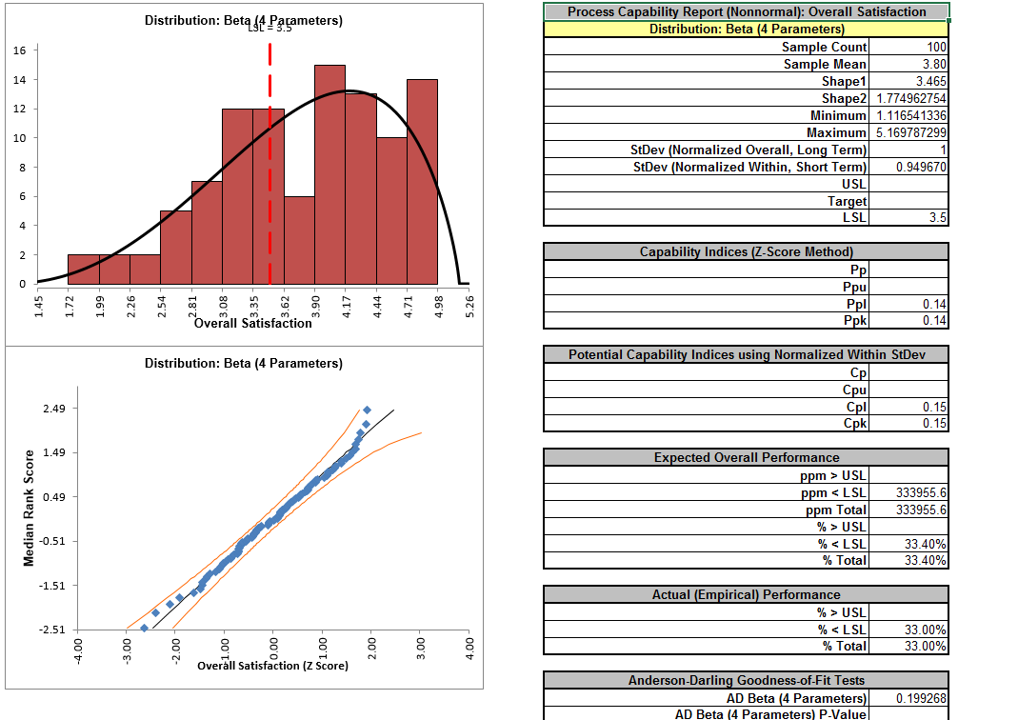
Demonstration: Nonnormal Process Capability – Overall Satisfaction

Slide 27
MIDACO-SOLVER
DiscoverSim is now bundled with MIDACO, one of the world’s strongest evolutionary solvers for mixed discrete, continuous, constrained global optimization.
MIDACO stands for Mixed Integer Distributed Ant Colony Optimization.
It is suitable for problems with up to several hundreds to some thousands of optimization variables.

Slide 28
MIDACO-SOLVER
MIDACO is a general-purpose software for solving mathematical optimization problems. Initially developed for Mixed Integer Nonlinear Programming (MINLP) problems arising from demanding space applications at the European Space Agency and Astrium (EADS), the software can be applied to a wide range of optimization problems.
MIDACO handles problems where the objective function f(x) depends on continuous, integer or both types (mixed integer case) of variables x. The problem might be further restricted to equality and/or inequality constraints g(x).

Slide 29
MIDACO-SOLVER
MIDACO holds the benchmark world record best solution to Full Messenger (Mission to Mercury), which is considered the most difficult space trajectory problem in the ESA Global Trajectory Optimization Database.

Slide 30
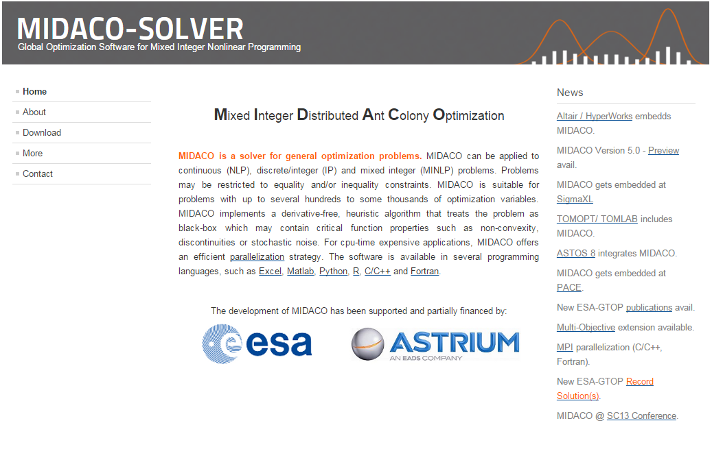
www.MIDACO-SOLVER.com

Slide 31
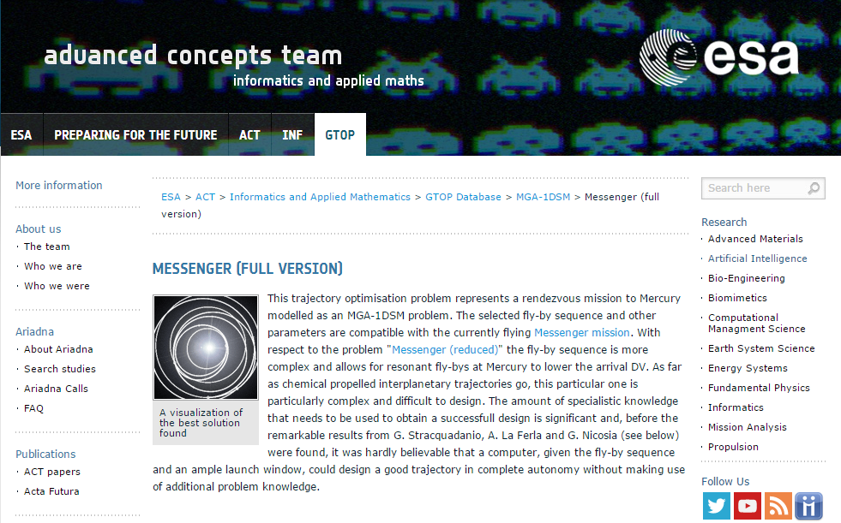
www.esa.int
It was developed in collaboration with the European Space Agency (ESA) and represents the state-of-the-art in interplanetary space trajectory optimization.
MIDACO holds the benchmark world record best solution to Full Messenger (Mission to Mercury), which is considered the most difficult space trajectory problem in the ESA Global Trajectory Optimization Database.

Slide 32
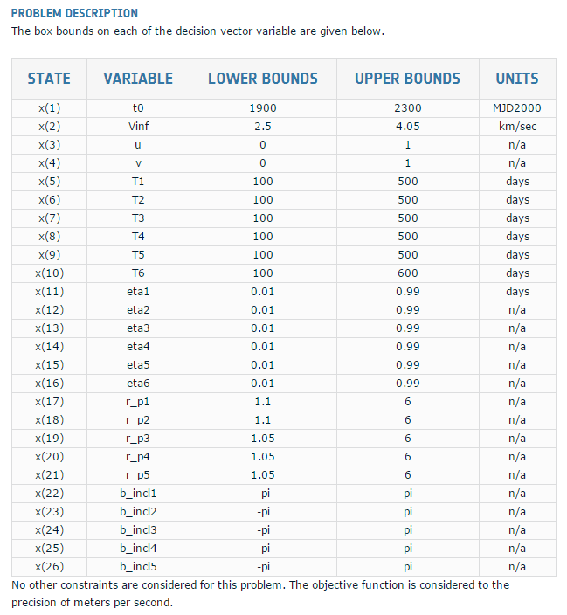

Slide 33
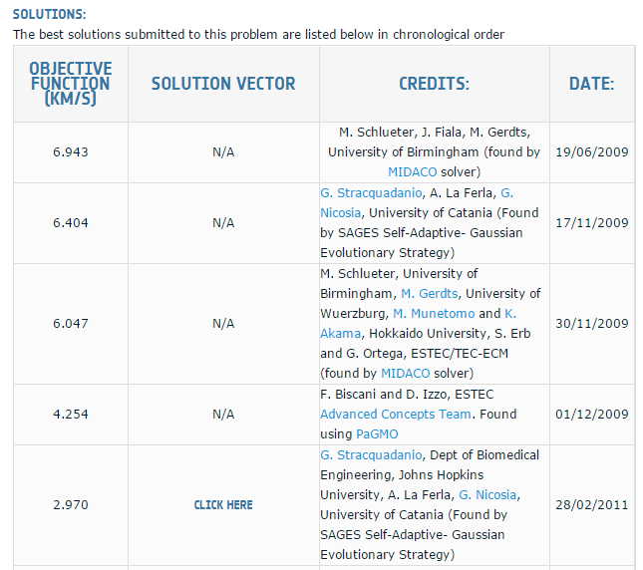

Slide 34
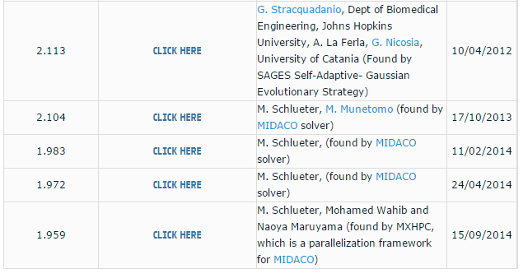

Slide 35
MIDACO-SOLVER
As a black-box optimizer, MIDACO does not require the objective and constraint functions to hold any particular property like convexity or differentiability.
MIDACO can robustly solve problems with critical function properties like high non-convexity, non-differentiability, flat spots and even stochastic noise.
Extensively tested on over a hundred benchmark problems and several real world applications, the software represents the state of the art for evolutionary computing on MINLP.

Slide 36
MIDACO-SOLVER: Ant Colony Optimization (ACO)
To find food, biological ants start to explore the area around their nest randomly at first. If an ant succeeds in finding a food source, it will return back to the nest, laying down a chemical pheromone trail marking its path. This trail will attract other ants to follow it in the hope of finding food again.
Over time the pheromones will start to evaporate and therefore reduce the attraction of the path, so only paths that are updated frequently with new pheromones remain attractive. Short paths from the nest to a food source imply short marching times for the ants, so those paths are updated with pheromones more often than long ones.
Consequently more and more ants will be attracted by the shorter paths with ongoing time. As a final result, a very short path will be discovered by the ant colony.

Slide 37
MIDACO-SOLVER
The MIDACO algorithm is based on a mixed integer extension of the Ant Colony Optimization (ACO) metaheuristic in combination with the Oracle Penalty Method for constraint handling.
The key element of MIDACO's ACO algorithm are so called “multi-kernel gaussian probability density functions” (Gauss PDF's), which are used to stochastically sample solution candidates (also called “ants” or “iterates”) for the optimization problem.
In case of integer variables, a discretized version of the Gauss PDF is applied instead of the continuous version.

Slide 38
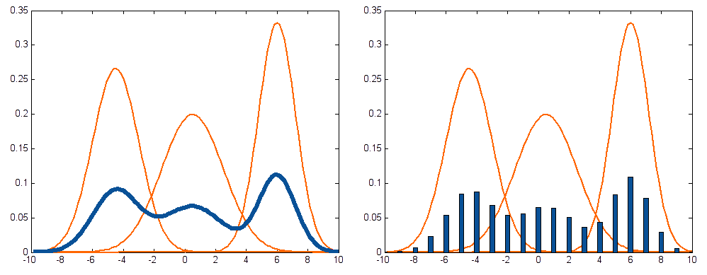
MIDACO-SOLVER
Continuous (left) and discretized (right) multi-kernel gaussian probability density functions (Gauss PDF's)

Slide 39
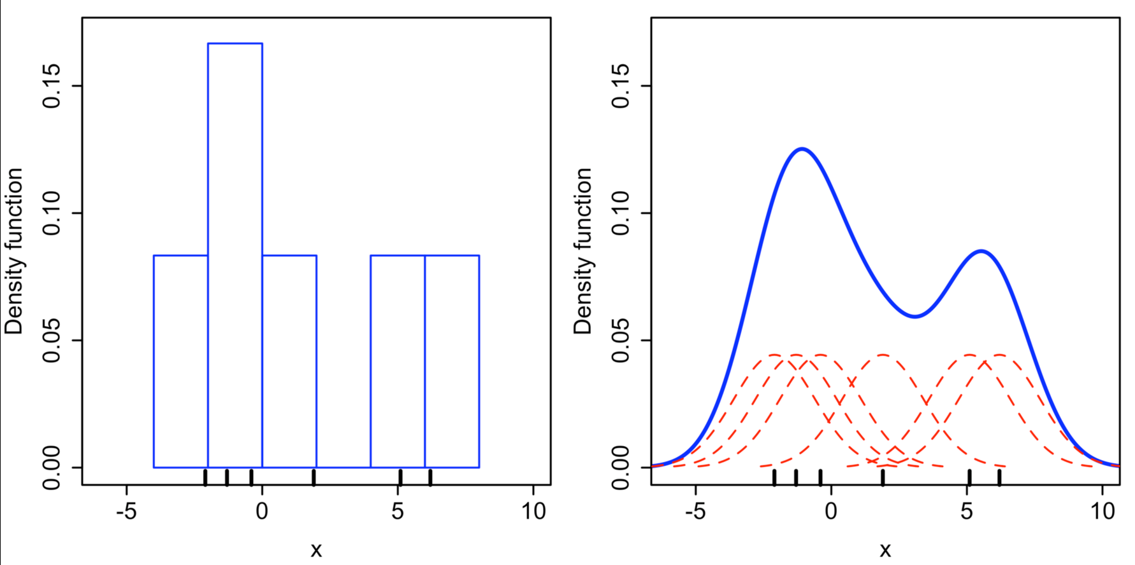
Wikipedia: Kernel Density Estimation
6 data points: x₁ = −2.1, x₂ = −1.3, x₃ = −0.4, x₄ = 1.9, x₅ = 5.1, x₆ = 6.2.
Comparison of the histogram (left) and kernel density estimate (right) constructed using the same data. The 6 individual kernels are the red dashed curves, the kernel density estimate the blue curves. The data points are the rug plot on the horizontal axis.

Slide 40
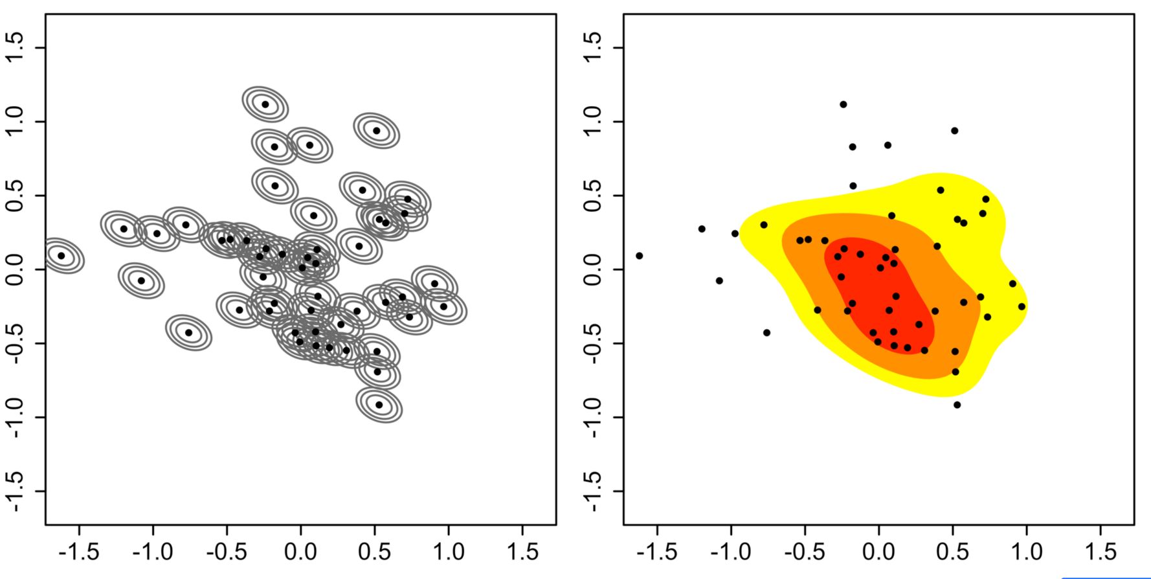
Wikipedia: Multivariate Kernel Density Estimation
Construction of 2D kernel density estimate. Left. Individual kernels. Right. Kernel density estimate.

Slide 41
Oracle Penalty Method
The oracle penalty method is an advanced approach for constraint handling within evolutionary optimization algorithms.
The method is based on a single parameter Omega (Ω), which is called an oracle due to its predictive nature. This parameter directly corresponds to the global optimal objective function value f(x).
In case of real-world applications where the user has some (rough) guess about a possible global optimal f(x) value, this information can be exploited as oracle information to improve the convergence speed of the optimization algorithm.

Slide 42
Oracle Penalty Method
In case no such user guided information is available, an (automated, self-tuning) update rule can be applied for Ω, starting with a value of infinity (∞) and updating Ω after individual optimization runs, when better (feasible) solutions have been found.
The oracle penalty method is one of the major reasons why MIDACO is capable to solve problems with up to hundreds of (non-linear) constraints.

Slide 43
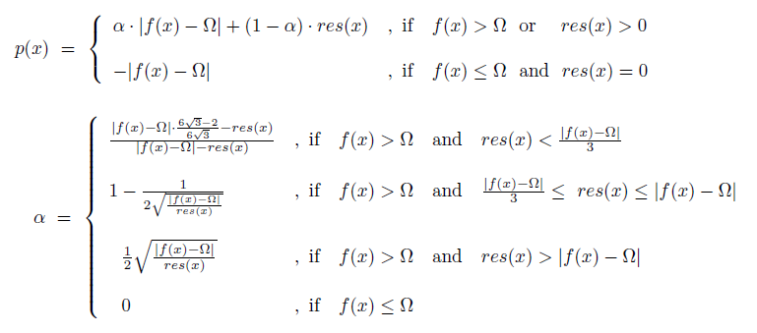
Mathematical Formulation of the Oracle Penalty Function

Slide 44
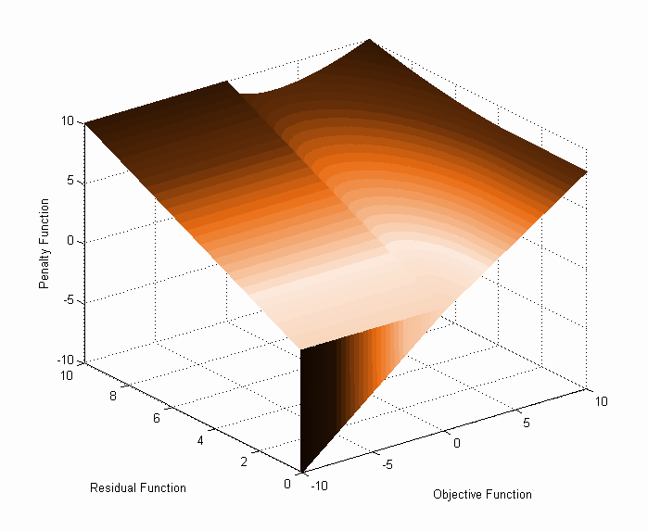
Oracle Penalty Method
Graphical illustration of the extended oracle penalty function for Omega = 0

Slide 45
Genetic Algorithm (GA)
The Genetic Algorithm (GA) is a derivative free global optimization method that attempts to find a global optimum by simulating an evolutionary process.
Each member of a population (a chromosome or solution) has a set of genes (parameter values). The members breed (crossover), and the genes can mutate.
Successful chromosomes – i.e., those that are most fit, as evaluated by the optimization process - survive, while the rest die. The parameters associated with the successful genes are returned.

Slide 46
Genetic Algorithm (GA)
GA is a useful complement to MIDACO and with some problems such as all continuous input control variables, may be faster to find a global optimum.
The MIDACO Oracle Penalty Method for constraints has been implemented in DiscoverSim’s GA.

Slide 47
Discrete Exhaustive
Discrete Exhaustive optimization is applicable for small problems where all of the input control variables are discrete. All combinations are evaluated and the best solution that satisfies all constraints (if applicable) is selected.
Obviously if the number of combinations is large then this method will not be feasible.

Slide 48
Discrete Exhaustive
A user defined Time Limit (default = 120 seconds) sets the maximum computation time. However, you won’t have to wait for this time to be exceeded if the problem is too large. After 50 trials, the average time per run is estimated and if this time, multiplied by the total number of combinations, exceeds the Time Limit, an error message is given and the optimization is stopped.
Practically this method will work well with binary discrete (2 levels) and up to 13 or 14 variables.

Slide 49
Sequential Quadratic Programming (SQP) Local Optimization
SQP is a very fast and robust algorithm for smooth local nonlinear continuous optimization. The objective function and the constraints must be twice continuously differentiable.
The method is based on solving a series of subproblems designed to minimize a quadratic model of the objective subject to a linearization of the constraints, using the Simplex algorithm.
If the problem is unconstrained, then the method reduces to Newton's method for finding a point where the gradient of the objective vanishes.

Slide 50
Nelder-Mead (NM) Local Optimization
The Nelder Mead algorithm is a fast downhill simplex method that provides a local optimum for an objective function when the gradients are not known (non-differentiable), so is suitable for non-smooth problems.
NM creates a simplex – an n+1 space – where each point (vertex) in the space represents an initial starting value. Each vertex is evaluated in terms of the criteria functions, the worst vertex is eliminated, and another vertex is added. The process is continued until no further reduction in the criteria function occurs.

Slide 51
Nelder-Mead (NM) Local Optimization
The creation of the new vertex involves reflection, expansion, contraction and shrinkage – the simplex changes shape and size at each iteration. The parameters allow one to influence how this process occurs.
The MIDACO Oracle Penalty Method for constraints has been implemented in DiscoverSim’s NM.

Slide 52
HYBRID Optimization
HYBRID optimization is a powerful hybrid of the 5 methods that takes advantage of the strengths of each method
All discrete controls: MIDACO or Exhaustive Discrete if applicable
All continuous controls: MIDACO, GA, followed by SQP or NM (if SQP fails due to non-smooth objective function). The solution from MIDACO provides starting values for GA. The solution for GA provides starting values for SQP/NM.

Slide 53
HYBRID Optimization
Mixed continuous/discrete controls: MIDACO 1 (Default settings), MIDACO 2 (Fine FOCUS = 100000), followed by SQP or NM. The solution from MIDACO 1 provides starting values for MIDACO 2. The solution for MIDACO 2 provides starting values for SQP/NM.
Note that using Hybrid will be slower than using a specific method, so if a quick solution is required, it is recommended to select one of the specific methods.
Future release will include more powerful hybrid with mixed global/local optimization.

Slide 54
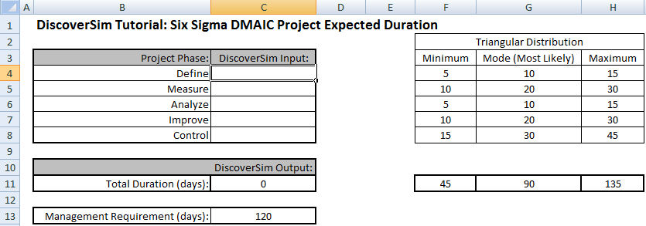
Getting Started Tutorial: Six Sigma Project Duration (Workbook, p. 29)
This is an example model of a Six Sigma project with five phases: Define, Measure, Analyze, Improve and Control. We are interested in estimating the total project duration in days. Management requires that the project be completed in 120 days.
We will model duration simply as:
Total Duration = Define + Measure + Analyze + Improve + Control

Slide 55
Getting Started Tutorial: Six Sigma Project Duration
We will model each phase using a Triangular Distribution, which is popular when data or theory is not available to estimate or identify the distribution type and parameter values.
Another similar distribution that is commonly used for project management is PERT.
The Minimum, Mode (Most Likely) and Maximum durations were estimated by the Six Sigma project team based on their experience.

Slide 56
Case Study: Six Sigma Project Selection (Workbook, p. 97)
This example was contributed by:
Dr. Harry Shah, Business Excellence Consulting.
A Six Sigma Champion must decide which Green Belt projects will be worked on for the next 6 months.
The goal is to select projects that maximize Total Expected Savings subject to a constraint of Total Resources <= 20 persons.
Management requires a minimum total project savings of $1 Million (i.e., Lower Specification Limit, LSL = 1000 $K)
We will explore the optimal selection of projects that maximize the Mean Savings and also consider minimizing variability by adding a DSIM_STDEV constraint.
  We could alternatively maximize the Process Capability Index Ppl.

Slide 57
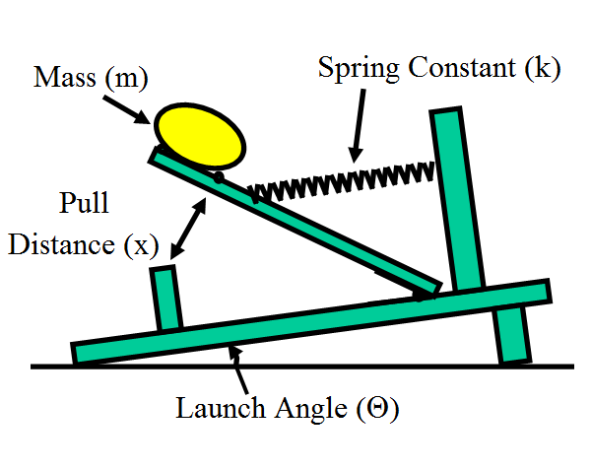
Case Study: Catapult Variation Reduction (Workbook p. 120)
This is an example of DiscoverSim stochastic optimization for catapult distance variation reduction, adapted from:
John O'Neill, Sigma Quality Management.
This example is used with permission of the author.
Notes:
See DiscoverSim Workbook for Case Study details.

Slide 58
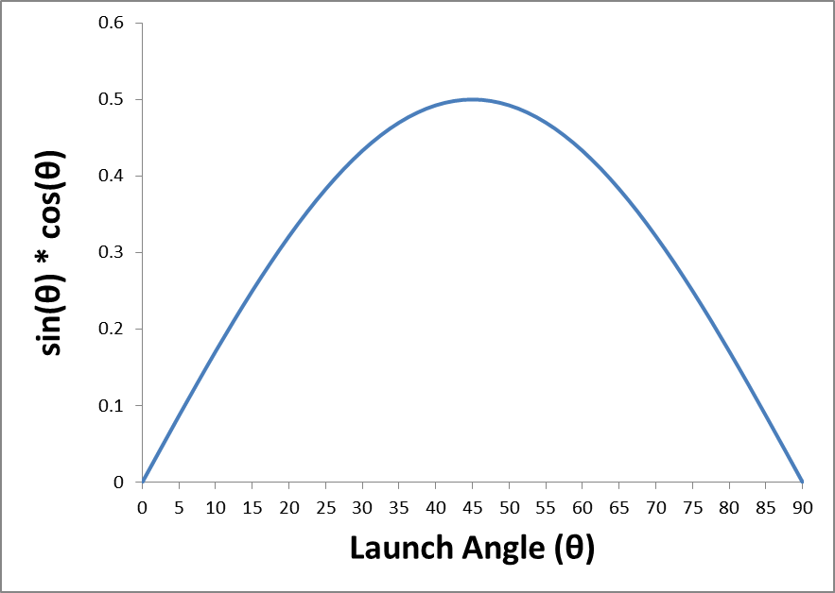
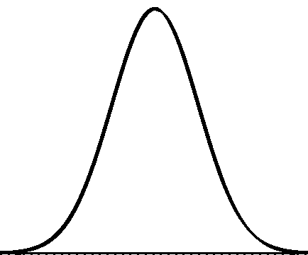
Optimization:
Stochastic Versus Deterministic
Stochastic optimization will not only find the optimum X settings that result in the best mean Y value, it will also look for a solution that will reduce the standard deviation.
Stochastic optimization looks for a minimum or maximum that is robust to variation in X, thus reducing the transmitted variation in Y. This is referred to as “Robust Parameter Design” in DFSS.

Slide 59
Case Study: Robust New Product Design - Optimizing Shutoff Valve Spring Force (Workbook, p. 137)
This is an example of DiscoverSim stochastic optimization for robust new product design, adapted from:
Sleeper, Andrew (2006), Design for Six Sigma Statistics: 59 Tools for Diagnosing and Solving Problems in DFSS Initiatives, NY, McGraw-Hill, pp. 782-789.
Sleeper, Andrew, “Accelerating Product Development with Simulation and Stochastic Optimization”, http://www.successfulstatistics.com/
This example is used with permission of the author.
Notes:
See DiscoverSim Workbook for Case Study details.

Slide 60
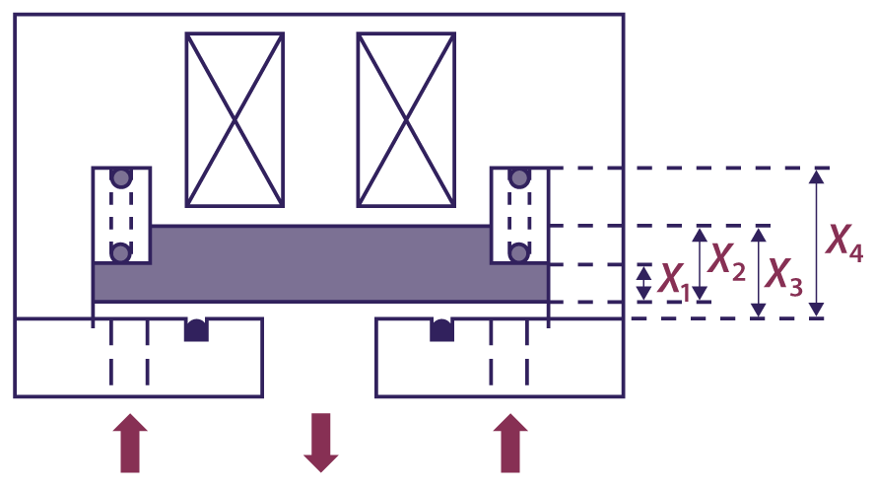
Case Study: Robust New Product Design - Optimizing Shutoff Valve Spring Force
The figure below is a simplified cross-sectional view of a solenoid-operated gas shutoff valve:
The arrows indicate the direction of gas flow.
A solenoid holds the plate (shaded) open when energized. When the solenoid is not energized, the spring pushes the plate down to shut off gas flow.
If the spring force is too high, the valve will not open or stay open. If the spring force is too low, the valve can be opened by the inlet gas pressure.

Slide 61
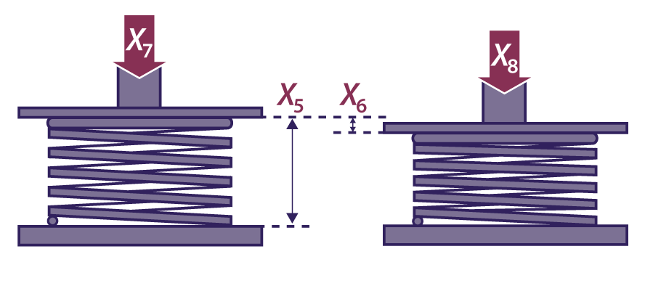
Optimizing Shutoff Valve Spring Force
The method of specifying and testing the spring is shown below:
The spring force requirement is 22 +/- 2 Newtons.
The spring force equation, or Y = f(X) transfer function, is calculated as follows:
Spring Length, L = -X1 + X2 - X3 + X4
Spring Rate, R = (X8 - X7)/X6
Spring Force, Y = X7 + R * (X5 - L)

Slide 62
What’s New in DiscoverSim Version 2
Questions?

